Slide 1
조강현 3차 발표자료

Slide 2
진척도
1. 도로 밑그림 완성
2. 적외선센서 사용성공
3. 코딩 진행중

Slide 3
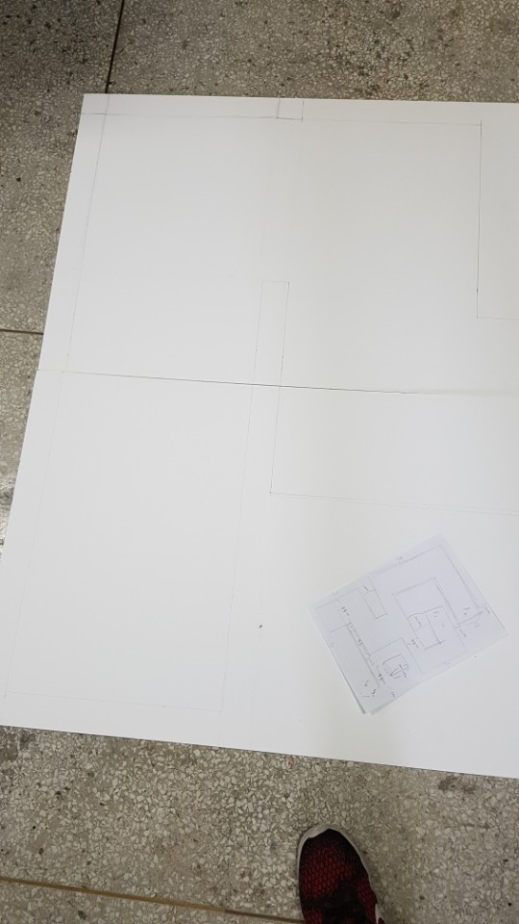
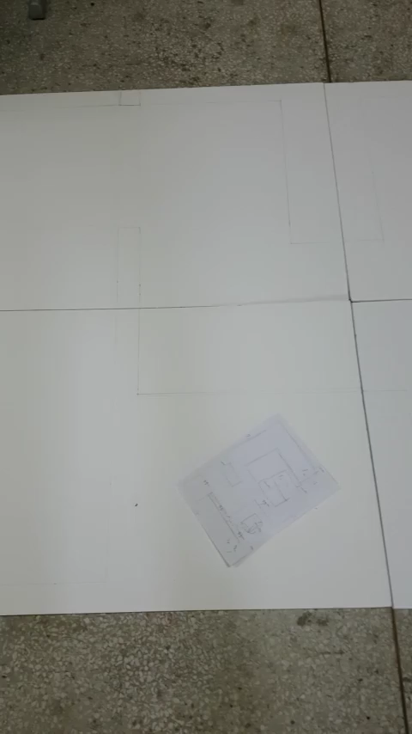
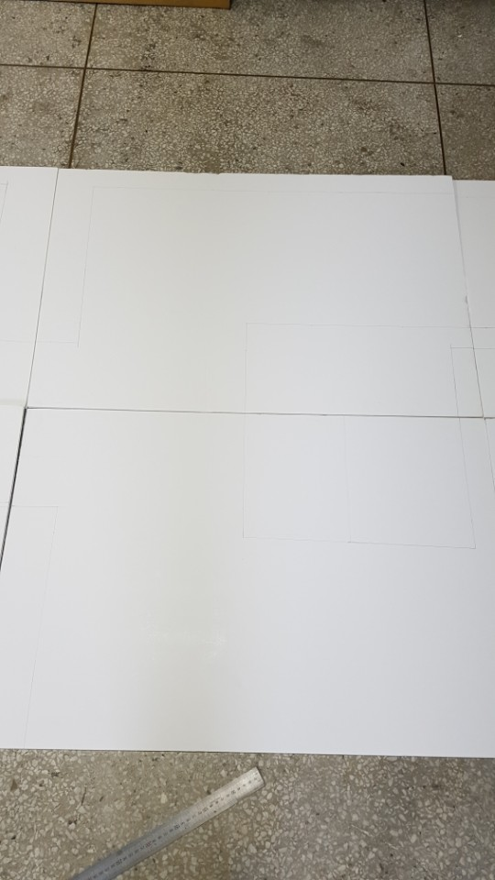
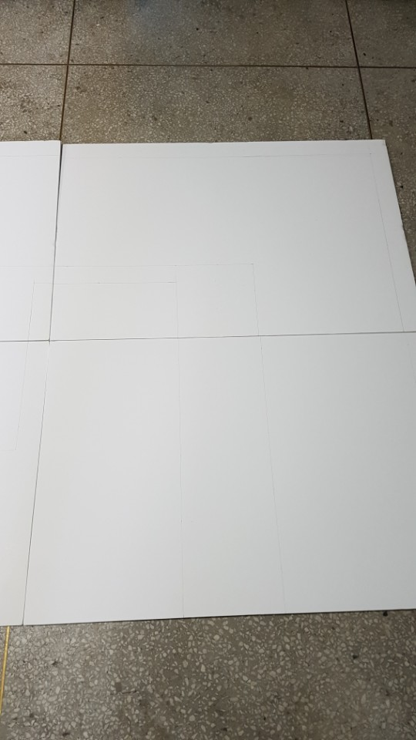
도로 밑그림 완성

Slide 4
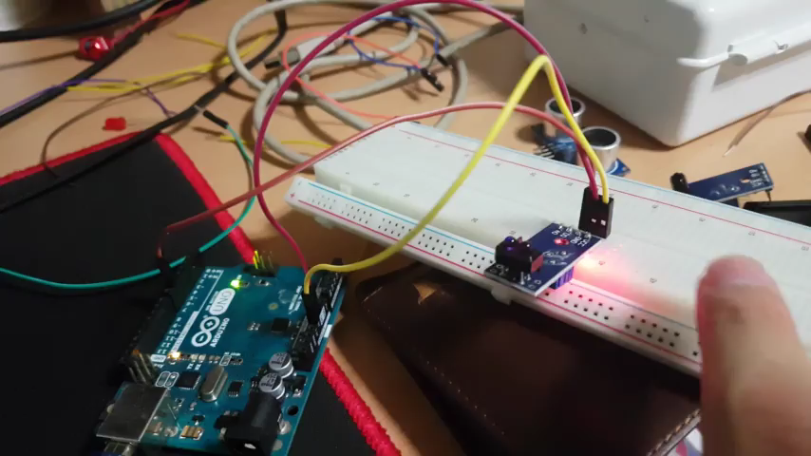
적외선 센서 사용

Slide 5
코딩 진행중
#define R_motor_f 8
#define R_motor_b 9
#define R_motor_speed A0
#define L_motor_f 10
#define L_motor_b 11
#define L_motorspeed A1
#define R_IR 12
#define L_IR 13
int type;
int F_Echo=0;
int R_Echo=0;
int L_Echo=0;
#include "Servo.h"
Servo steer_servo;
//초음파 번호
#define Front_Echo 2
#define Front_Trig 3
#define Right_Side_Echo 4
#define Right_Side_Trig 5
#define Left_Side_Echo 6
#define Left_Side_Trig 7
//모터 번호

Slide 6
void setup() {
pinMode(Front_Trig, OUTPUT);
pinMode(Front_Echo, INPUT);
pinMode(Right_Side_Trig, OUTPUT);
pinMode(Right_Side_Echo, INPUT);
pinMode(Left_Side_Trig, OUTPUT);
pinMode(Left_Side_Echo, INPUT);
pinMode(R_motor_f, OUTPUT);
pinMode(R_motor_b, OUTPUT);
pinMode(R_motor_speed, OUTPUT);
pinMode(L_motor_f, OUTPUT);
pinMode(L_motor_b, OUTPUT);
pinMode(L_motorspeed, OUTPUT);
pinMode(A0, INPUT);
pinMode(A1, INPUT);
}
void loop() {
digitalWrite(Front_Trig, HIGH);
delayMicroseconds(10);
digitalWrite(Front_Trig, LOW);
F_Echo = pulseIn(Front_Echo, HIGH)/58.2;
digitalWrite(Right_Side_Trig, HIGH);
delayMicroseconds(10);
digitalWrite(Right_Side_Trig, LOW);
R_Echo = pulseIn(Right_Side_Echo, HIGH)/58.2;
digitalWrite(Left_Side_Trig, HIGH);
delayMicroseconds(10);
digitalWrite(Left_Side_Trig, LOW);
L_Echo = pulseIn(Left_Side_Echo, HIGH)/58.2;

Slide 7
if(F_Echo>30){
type=1;
}
if(F_Echo<30){
type=2;
}
if(F_Echo<10&&R_Echo<10){
type=3;
}
if(F_Echo<10&&L_Echo<10){
type=4;
}
if(F_Echo<10&&R_Echo<10&&L_Echo<10){
type=5;
}
switch (type){
case 1:{
digitalWrite(R_motor_f,HIGH);
digitalWrite(R_motor_b,LOW);
analogWrite(R_motor_speed,255);
digitalWrite(L_motor_f,HIGH);
digitalWrite(L_motor_b,LOW);
analogWrite(L_motorspeed,255);
break;
}
case 2:{
digitalWrite(R_motor_f,HIGH);
digitalWrite(R_motor_b,LOW);
analogWrite(R_motor_speed,150);
digitalWrite(L_motor_f,HIGH);
digitalWrite(L_motor_b,LOW);
analogWrite(L_motorspeed,150);
break;
}

Slide 8
Q&A

